Slide 1

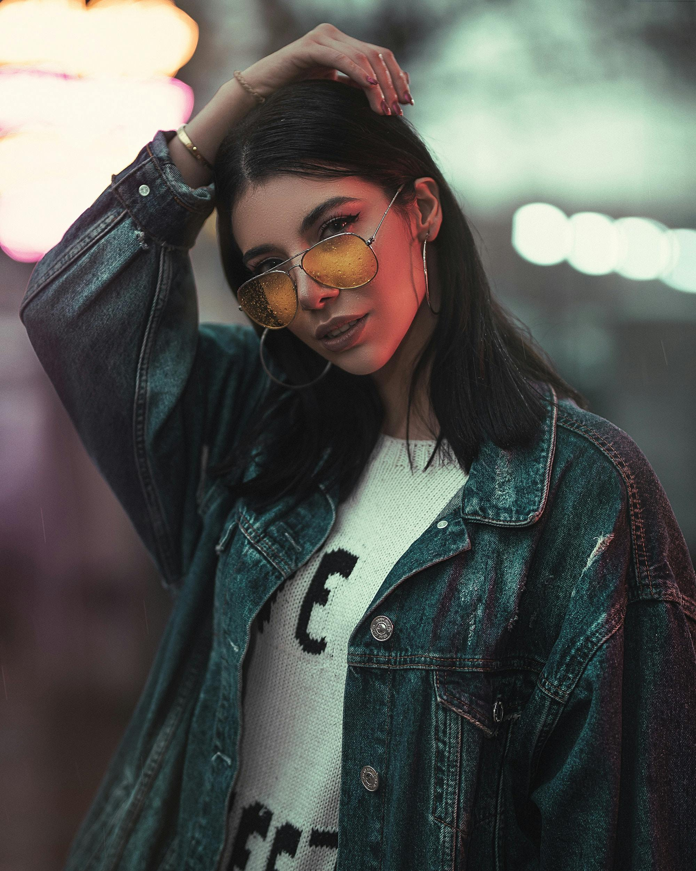
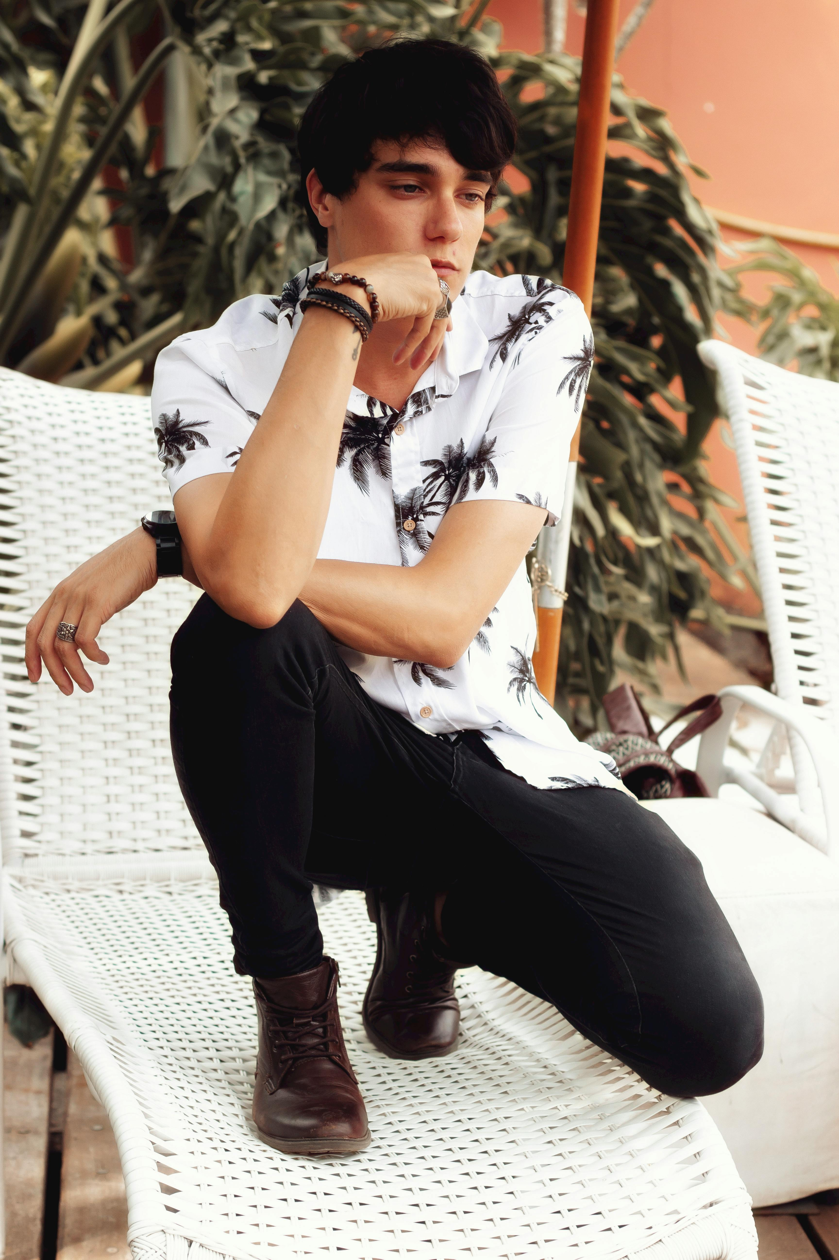

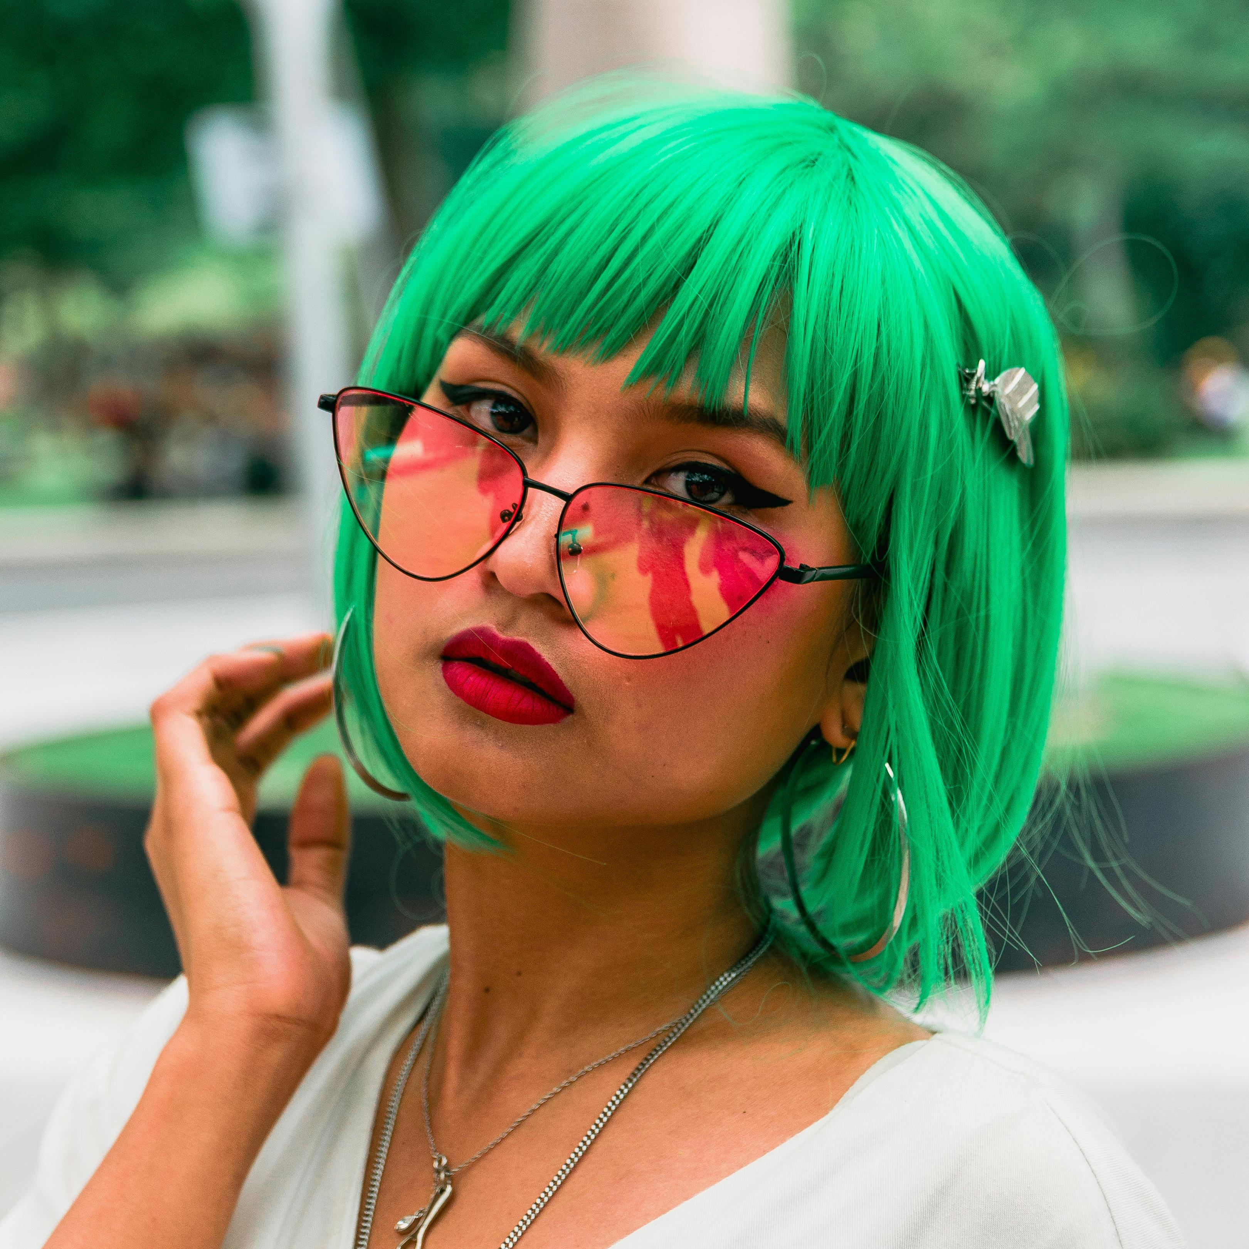
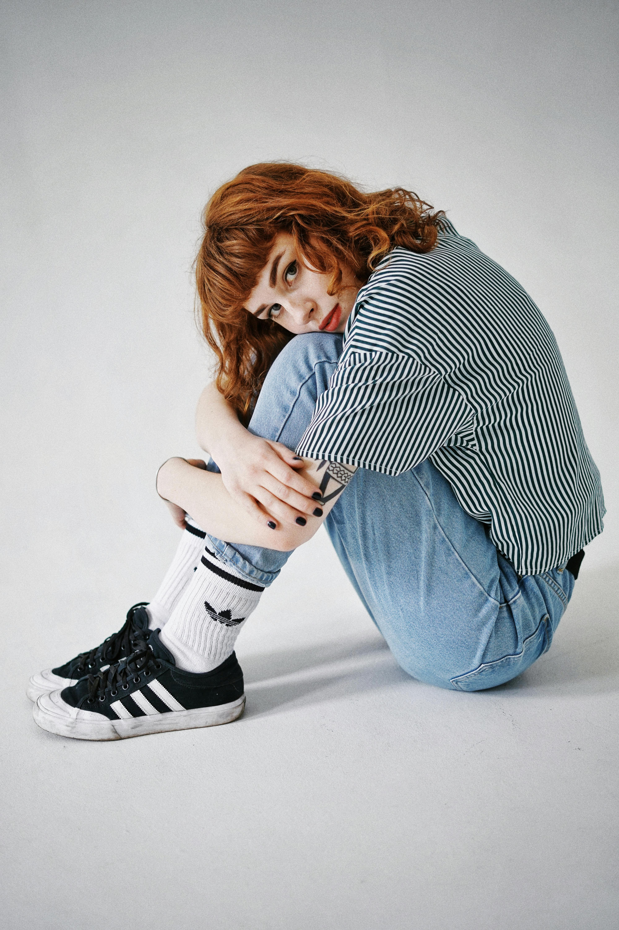
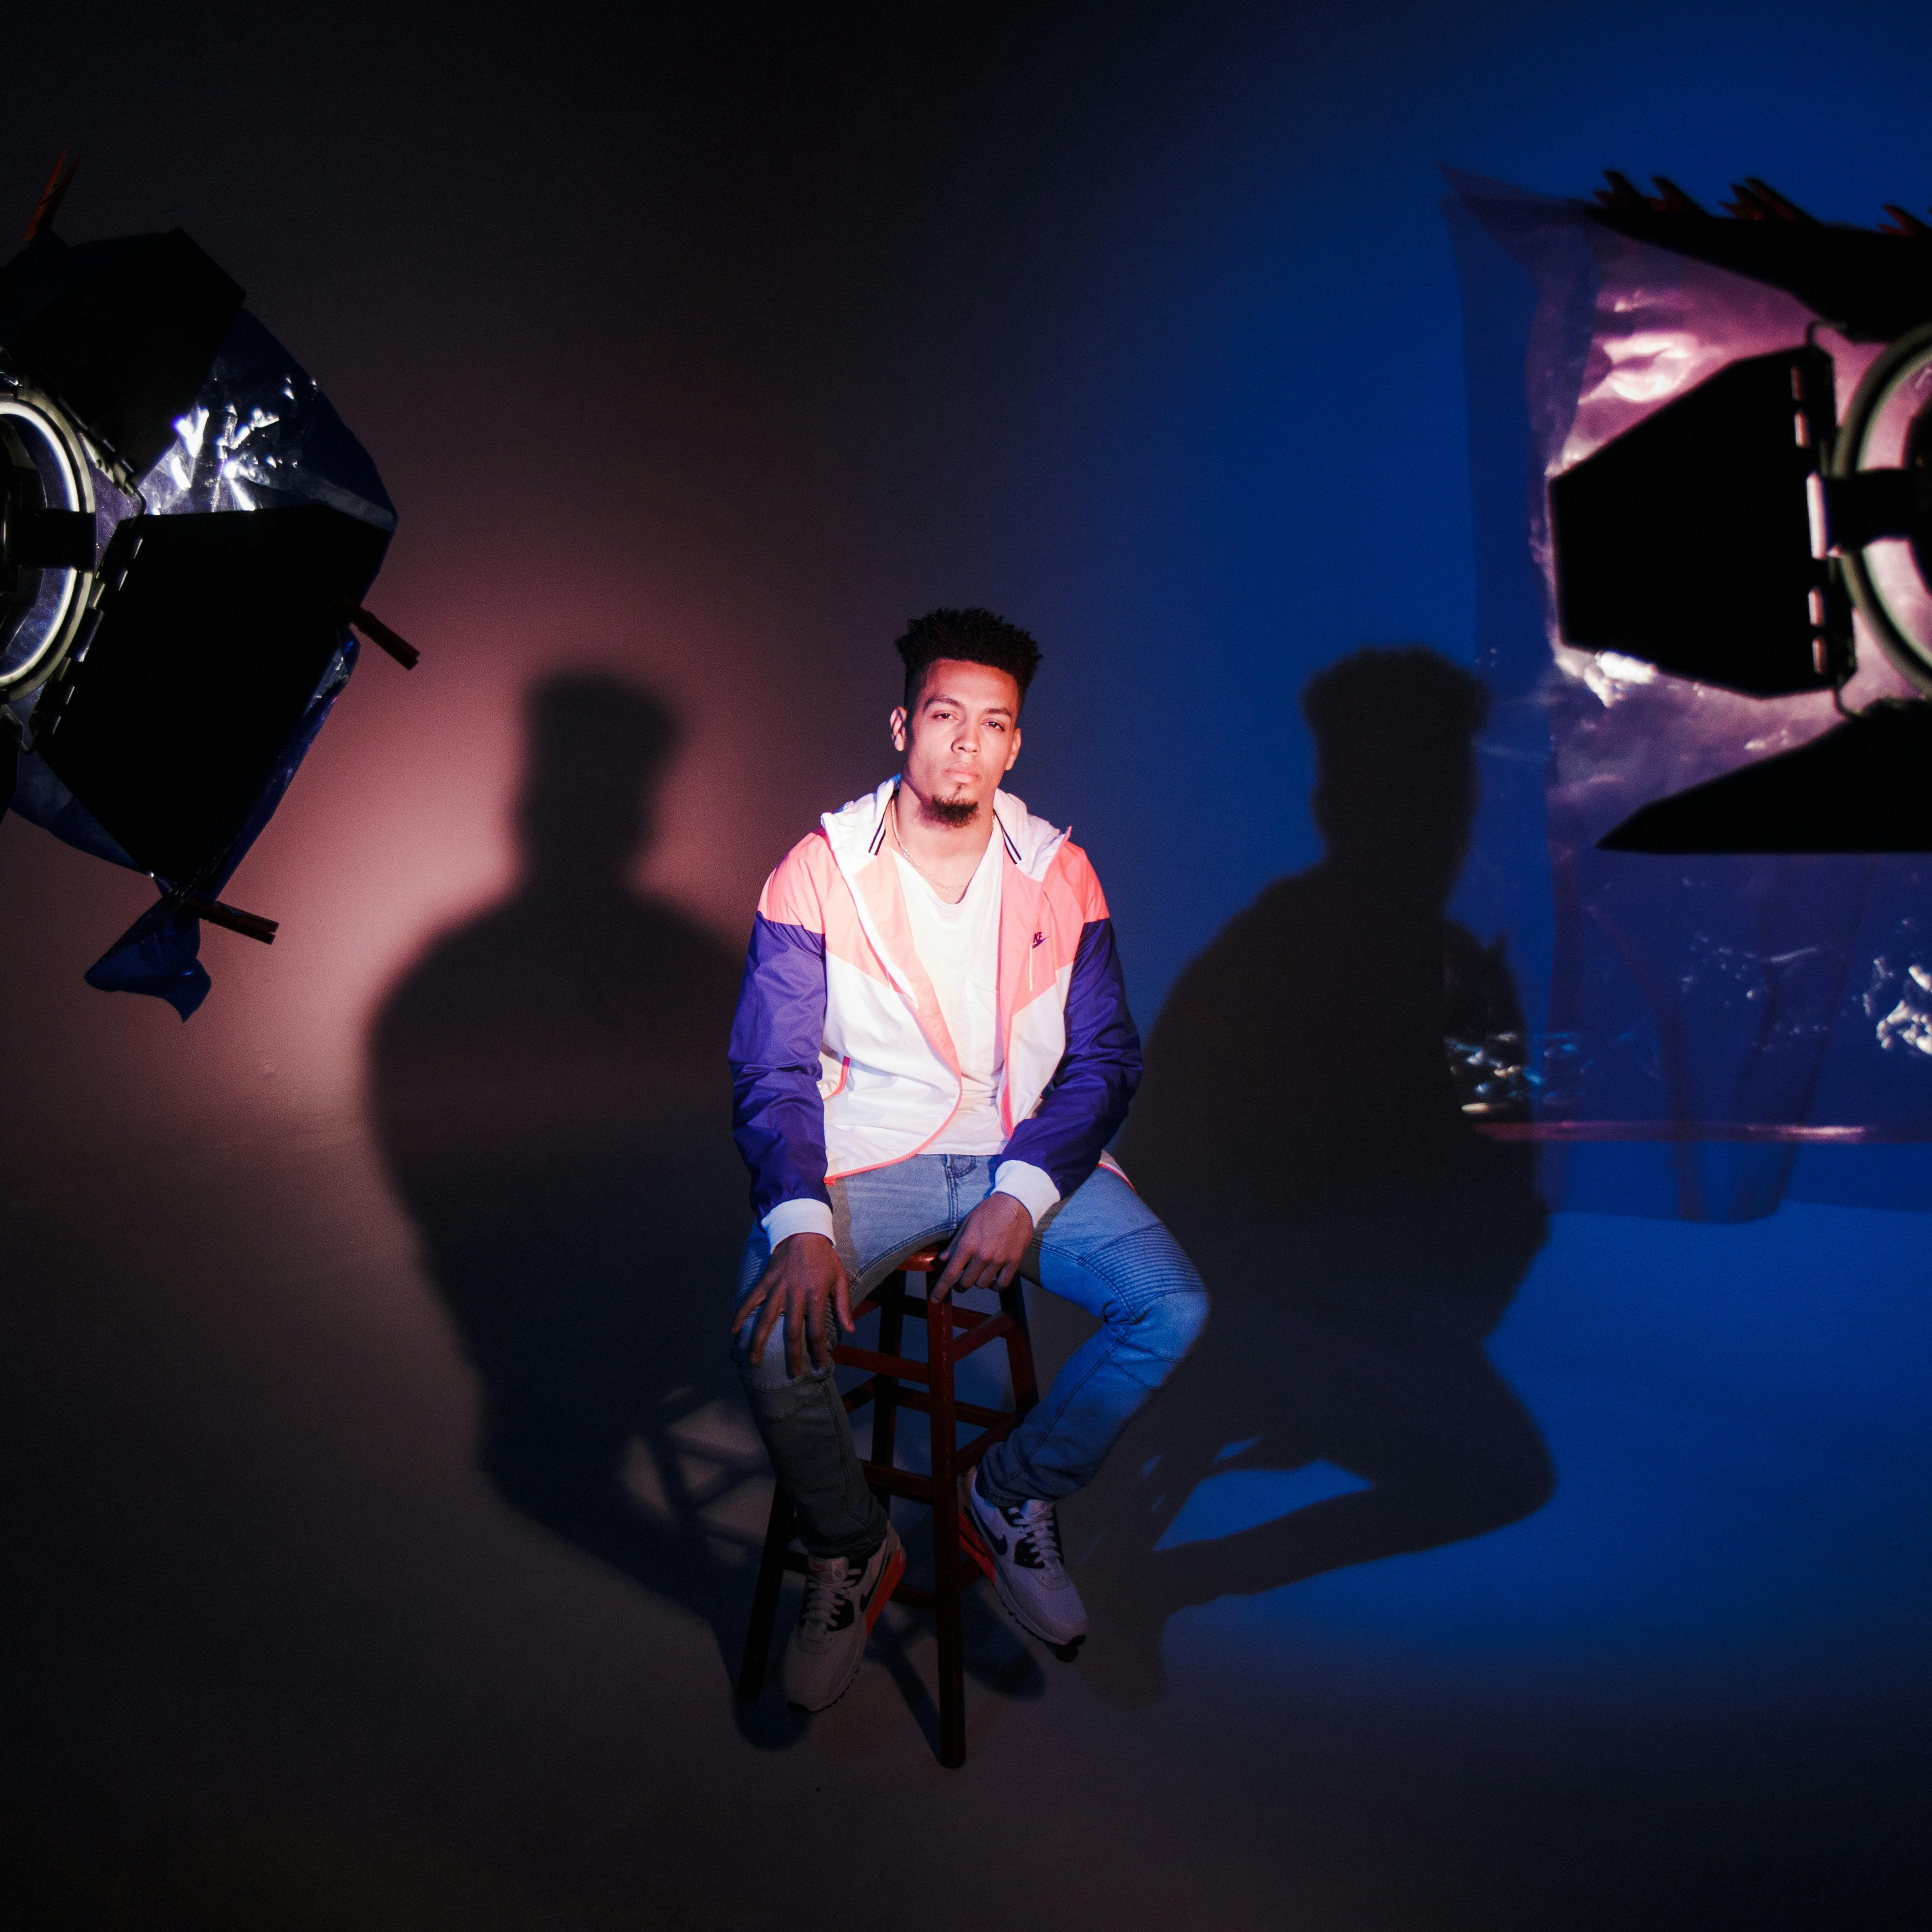
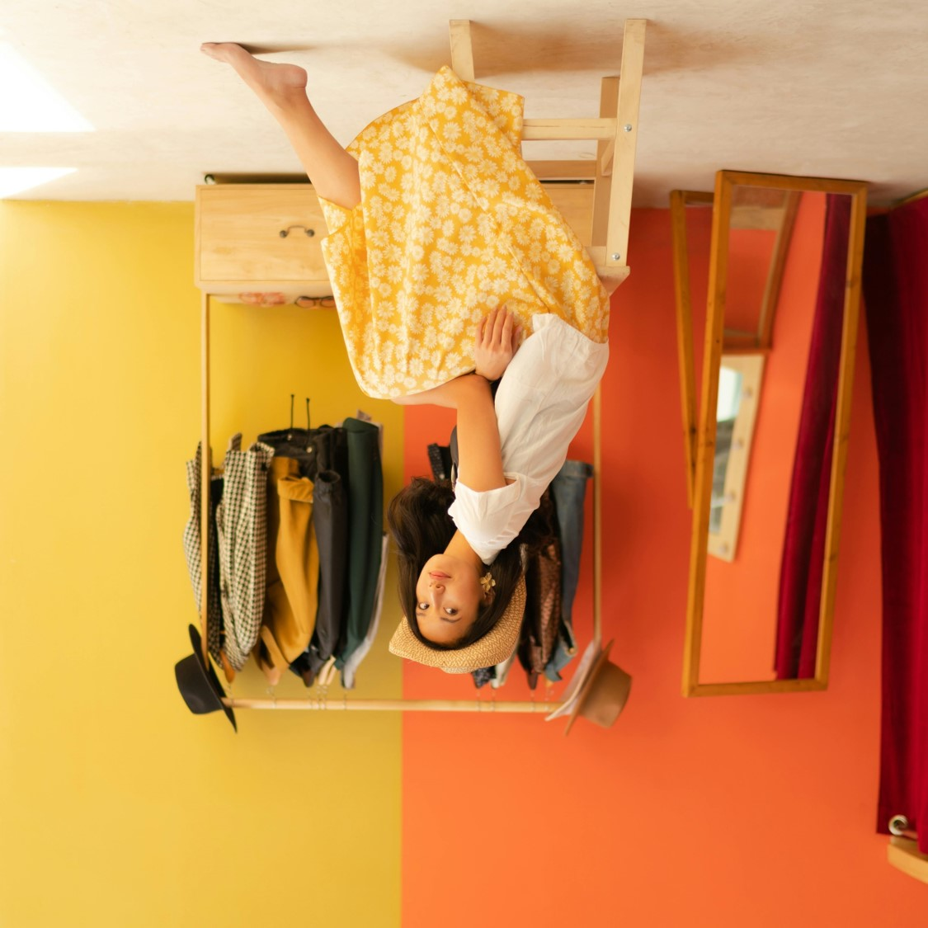
Fashionyzer
About us
Talk to us
Feeling lost in the fast-paced world of fashion trends?
Well that’s why we’re here,
To save YOU!
Bollywood Trends
Cord Sets
Floral Shirts
Denim Jackets
Seasonal Trends
Cord Sets
Floral Shirts
Denim Jackets
Browse by Gender
MEN
WOMEN

Slide 2

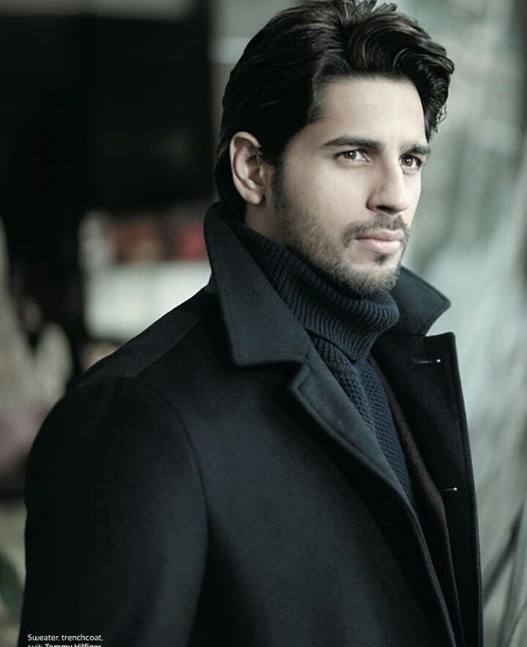


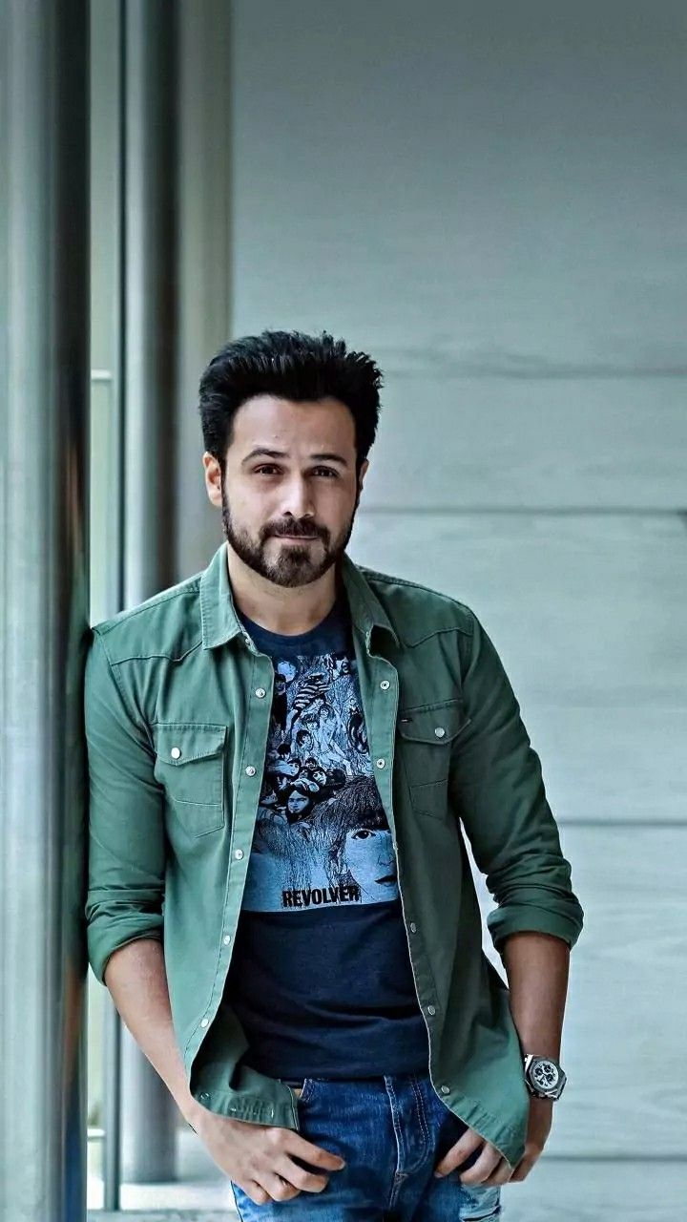
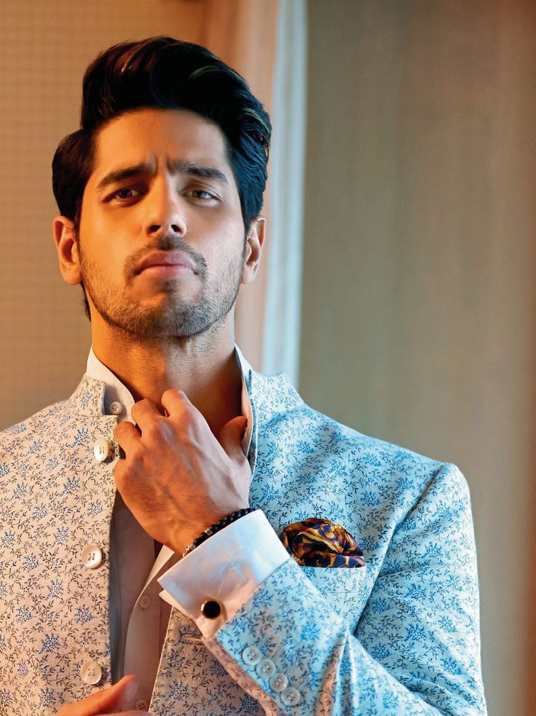
Fashionyzer
About us
Talk to us
Trends by Bollywood
Trends by Comfort
Trends by Season

Slide 3
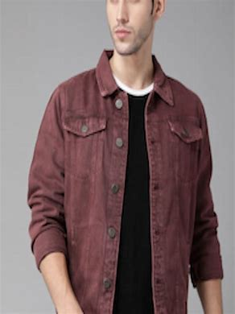
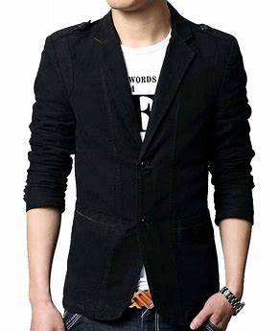
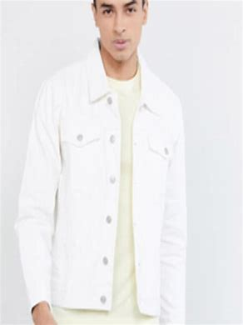
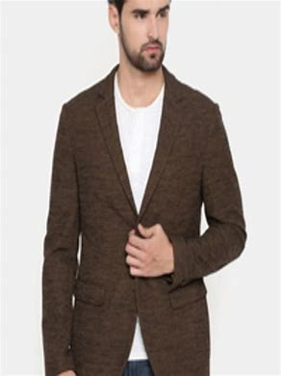
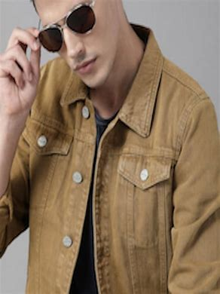
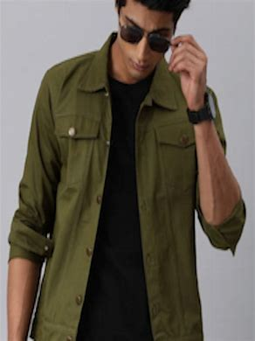
Fashionyzer
About us
Talk to us
Trends by Bollywood
Top matching products
Top matching products
Denim Jackets
Black Blazer

